Slide 1
Week 5&7_Part 2_Feasibility (Non-economics Appraisal Cont'd)

Slide 2
We are going to add one additional Q&A on the Week 9 Wednesday from 5:30-7:00pm.

Slide 3
Major types of non-economics-based techniques
Dominance
Maxmin
Maximax
Conjunctive method
Disjunctive method
Lexicographic method
Elimination by aspect
Simple additive weighting method
Weighted product
Topsis
Electre
PROMETHEE
Median Ranking Method
Scaled checklist
Rank-sum method
Analytical Hierarchy Process (AHP)
Simple Multi-attribute Technique (SMART)

Slide 4
Dominance
An option is dominated if another option exists that performs better than it on one or more of the decision criteria and equals it on the remainder:
Compare the first two options; if one is dominated by the other, discard the dominated one
Compare the retained option with the third option and again discard the dominated one
Then introduce the fourth option and so on as before
If the process involves n project options the process requires n – 1 steps
Notes:
It is a screening or ‘sieving’ process, where the options being evaluated are reduced to a shortlist by eliminating all those that are dominated.

Slide 5
Developers are considering 7 potential sites as per the following 3 attributes:
A good supply of water and manpower (C1)
A positive community attitude to water pollution (C2)
A small likelihood of union formation (C3)
C1 and C2 are measured on a four-point scale: poor – fair – good – excellent. C3 is measured as a probability from zero to one (Organisation would prefer not to deal with Union)
 | C1 | C2 | C3
S1 | Poor | Good | 0.5
S2 | Excellent | Fair | 1
S3 | Poor | Poor | 1
S4 | Fair | Fair | 0.1
S5 | Good | Excellent | 0.2
S6 | Fair | Good | 0.9
S7 | Good | Fair | 1

Slide 6
Solution

Slide 7
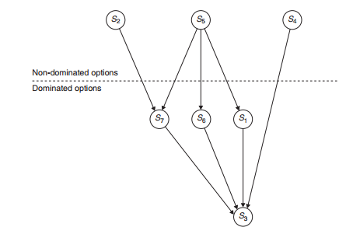
Solution
Better site options

Slide 8
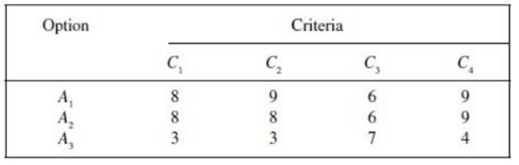
Sometimes some dominated options might, in overall terms, be better than some of the non-dominated options.
Notes:
There is no way to perform “dominance” in this case where A2 is dominated by A1 (A2 can be ruled out) but A3 is not dominated. Conjunctive Method may help, before Dominance method.

Slide 9

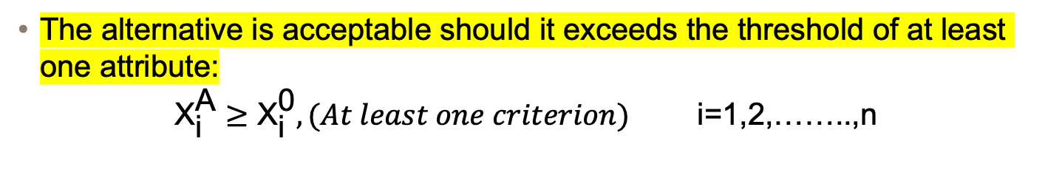
Conjunctive method
Conjunctive: a minimal performance threshold is introduced for each attribute and alternatives are analysed against all attributes accordingly
An alternative is acceptable only if it exceed the attribute of all attributes:
$${\text{X}}_{\text{i}}^{\text{A}}≥{\text{X}}_{\text{i}}^{\text{0}},(All criteria) \text{i}\text{=1,2,……..,}\text{n}$$
Disjunctive method
The alternative is acceptable should it exceeds the threshold of at least one attribute:
$${\text{X}}_{\text{i}}^{\text{A}}≥{\text{X}}_{\text{i}}^{\text{0}},(At least one criterion) \text{i}\text{=1,2,……..,}\text{n}$$

Slide 10
Using Conjunctive Method: purchasing a new type of vehicles; the choice is between four models. Six criteria (C1 to C6) are used to assess the options:
The decision follows the below cut-offs:
C1≥ 100；C2≥ 1500；C3≥ 2000；C4≤ 60；C5≥ Fair；C6≥ Fair
 | C1 (max speed, km/h) | C2 (operating range, km) | C3 (max payload,kg) | C4 (…) | C5 (…) | C6 (…)
A1 | 100 | 1500 | 2000 | 55 | Fair | Excellent
A2 | 125 | 2700 | 1800 | 65 | Poor | Fair
A3 | 90 | 2000 | 2100 | 45 | Good | Good
A4 | 110 | 1800 | 2000 | 50 | Fair | Fair

Slide 11
Max-Min
The method is based upon the Decision-maker’s attitude towards the decision environment.
When the decision-maker has a pessimistic attitude, the method picks the ‘best out of the worst attribute ratings’.
In contrast to Max-Min, Max-Max assumes the decision-maker has an optimistic attitude. Therefore, ‘best out of the best attribute ratings’.
Max-Max

Slide 12
A local authority wishes to select a site for a major regional landfill facility. There are 6 site options, namely, S1 to S6, that are put forward for consideration on the following five criteria: C1: road access; C2: effect on the landscape; C3: proximity to centres of population; C4: ecology; C5: archaeological significance. All criteria are scored on a 10-point scale from 1 (worst) to 10 (best). Following Table gives the decision matrix for the six sites:
Site | Criteria |  |  |  |  | Max-Min | Max-Max
 | C1 | C2 | C3 | C4 | C5
A1 | 4 | 6 | 3 | 2 | 3
A2 | 7 | 2 | 8 | 2 | 4
A3 | 8 | 5 | 4 | 6 | 3
A4 | 6 | 7 | 5 | 5 | 6
A5 | 3 | 5 | 6 | 8 | 7
A6 | 8 | 9 | 2 | 8 | 8
When using Max-Min, perform a horizontal checking on the Min ratings first;
When using Max-Max, perform a horizontal checking on the Max ratings first

Slide 13
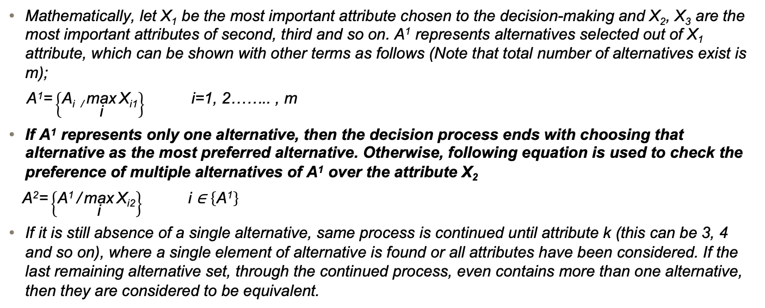
Lexicographic method
Check the decision option/options based on the criteria significance level - that is, a decision maker should follow a sequential manner, namely, starting from the most important criterion, then moving to the second most important one, then the third… and all the way to the least important one; stop at anywhere until the required option/options are screened out.
Mathematically, let X₁ be the most important attribute chosen to the decision-making and X₂, X₃ are the most important attributes of second, third and so on. A¹ represents alternatives selected out of X₁ attribute, which can be shown with other terms as follows (Note that total number of alternatives exist is m);
$\text{A}\text{1}\text{=}\left\{\text{A}\text{i}\text{ /}\underset{\text{i}}{\text{max}}{\text{X}\text{i}\text{1}}\right\} \text{i}\text{=1, 2…….. , }\text{m}$
If A¹ represents only one alternative, then the decision process ends with choosing that alternative as the most preferred alternative. Otherwise, following equation is used to check the preference of multiple alternatives of A¹ over the attribute X₂
$\text{A}\text{2}\text{=}\left\{\text{A}\text{1} \text{/}\underset{\text{i}}{\text{max}}{\text{X}\text{i}\text{2}}\right\} \text{i}\text{ ∈ }\left\{\text{A}\text{1}\right\}$
If it is still absence of a single alternative, same process is continued until attribute k (this can be 3, 4 and so on), where a single element of alternative is found or all attributes have been considered. If the last remaining alternative set, through the continued process, even contains more than one alternative, then they are considered to be equivalent.

Slide 14
Choose a dumper truck, 8 models to choose, 4 criteria. The decision follows the importance order: C3->C1->C4->C2. Identify the best model/models that satisfy the threshold requirements of C3>2, C1>8000, C4<11, C2>1500.
Option | Criteria
 | C1 (list price) | C2 (resale value) | C3 (handling) | C4 (acceleration)
M1 | 7300 | 3000 | 7 | 14.7
M2 | 9600 | 3600 | 7 | 19.1
M3 | 10580 | 3600 | 7 | 10.8
M4 | 13700 | 6000 | 7 | 13.0
M5 | 29850 | 12000 | 4 | 13.7
M6 | 11050 | 3600 | 4 | 16.2
M7 | 9800 | 3600 | 7 | 15.3
M8 | 276 | 12000 | 1 | 13.5
Solution:
On the most important criterion C3 (handling), M1, M2, M3, M4 and M7 are screened out. If the decision process stops here, then M1, M2, M3 and M4.
On the second most important criterion C1 (list price), M1, M2, M3 and M7 still remain. If the decision process stops here, then M2, M3 and M4.
On the third most important criterion C4 (acceleration), only M3 falls within the threshold value of 11 seconds. If the decision process stops here, M3 is solely chosen and no need to examine C2.

Slide 15
Scaled Checklist Method
List all the selection criteria;
Determine the criteria weightings;
Score your options as against each criterion (using a scale from the worst “-5” to the best “5”);
Calculate the weighted scores of your options (i.e. Step 2 x Step 3);
Total the weighted scores for your options;
Choose the best option upon the maximum weighted score obtained

Slide 16
Example:
1 - Criteria | 2 - Weights | 3 - Raw Scores
 |  | Option 1 | Option 2 | Option 3
C1
C2
C3
C4
C5
C6
C7
C8
4 - Weighted Scores
Option 1 | Option 2 | Option 3
5 - Total Weighted Scores
6 - Make your decision
Notes:
Total the weighted scores for your options

Slide 17
Example:
Criteria | weights | Scores
 |  | Option 1 | Option 2 | Option 3
C1 | 2 | -1 | 1 | 2
C2 | 2 | 1 | 1 | 2
C3 | 4 | 3 | 0 | 4
C4 | 1 | 2 | -2 | -4
C5 | 1 | -2 | 3 | -2
C6 | 2 | 2 | 4 | 0
C7 | 1 | 5 | 3 | -2
C8 | 2 | -1 | -3 | -1
Weighted Score
Plan 1 | Plan 2 | Plan 3
-2 | 2 | 4
2 | 2 | 4
12 | 0 | 16
2 | -2 | -4
-2 | 3 | -2
4 | 8 | 0
5 | 3 | -2
-2 | -6 | -2
19 | 10 | 14
Best Option

Slide 18
Interestingly, to be able to use the Scaled Checklist method, we need to fairly determine the weighting of each criterion, but how?
A method called Rank-sum Method may help, see the following case:
Two options have been proposed for the location of a new power plant in Victoria, six criteria have been identified by which to select the option, and three experts were surveyed to determine the importance of each criterion.
Criteria (n=6) | Expert A Rank | Expert B Rank | Expert C Rank | Rank Magnitude | Determine the Rank Position (r) | Rating (n-r+1) | Weighting
C1 | 2nd | 5th | 5th
C2 | 1st | 2nd | 4th
C3 | 6th | 3rd | 6th
C4 | 4th | 1st | 3rd
C5 | 3rd | 6th | 2nd
C6 | 5th | 4th | 1st

Slide 19
Criteria (n=6) | Expert A Rank | Expert B Rank | Expert C Rank | Rank Magnitude | Determine the Rank Position (r) | Rating (n-r+1) | Weighting
C1 | 2nd | 5th | 5th | 12 | 5th | 2 | 0.095
C2 | 1st | 2nd | 4th | 7 | 1st | 6 | 0.286
C3 | 6th | 3rd | 6th | 15 | 6th | 1 | 0.048
C4 | 4th | 1st | 3rd | 8 | 2nd | 5 | 0.238
C5 | 3rd | 6th | 2nd | 11 | 4th | 3 | 0.143
C6 | 5th | 4th | 1st | 10 | 3rd | 4 | 0.190

Slide 20
Next, ask the project stakeholders to vote the options (using a 1-10 scale)
Criteria | Score (Out of 10)
 | Option A | Option B
C1 | 7 | 4
C2 | 5 | 6
C3 | 6 | 5
C4 | 4 | 7
C5 | 7 | 8
C6 | 8 | 6
Weighted score
Option A | Option B
0.665 | 0.380
1.430 | 1.716
0.288 | 0.240
0.952 | 1.666
1.001 | 1.144
1.520 | 1.140
5.856 | 6.286
Weighting
0.095
0.286
0.048
0.238
0.143
0.190
Best Option

Slide 21
Analytical Hierarchy Process (AHP)
AHP is a technique that transforms qualitative data to quantitative data, which therefore becomes comparable
AHP is mainly based on pair-wise comparison data to compare criteria
Scale | Linguistic definition
1 | Equally (1X) importance of both elements
3 | Moderate (3X) importance of one element over another
5 | Strong (5X) importance of one over another
7 | Very strong (7X) importance of one over another
9 | Absolute (9X) importance of one over another
2, 4, 6, 8 | Intermediate values

Slide 22
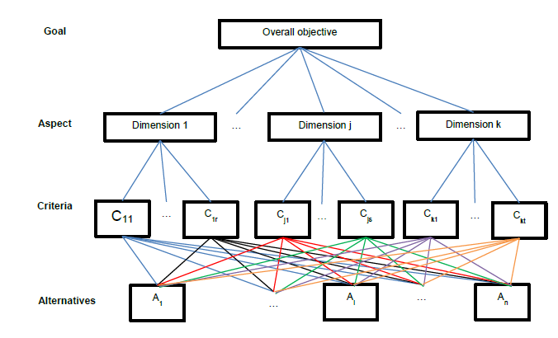
Process of Implementing AHP
Hierarchic design
Capturing of pair-wise comparison data
Performance aggregation through analysis

Slide 23
Step 1: Form the pairwise comparison matrix
$\text{P}\text{ = }\left[\begin{matrix}\text{1} & \text{P}\text{12} & \text{P}\text{13} & \text{⋯} & \text{⋯} & \text{P}\text{1}\text{n}∗ \\ \text{1/}\text{P}\text{12} & \text{1} & \text{P}\text{23} & \text{⋯} & \text{⋯} & \text{P}\text{2}\text{n} \\ \text{1/}\text{P}\text{13} & \text{1/}\text{P}\text{23} & \text{1} & \text{⋯} & \text{⋯} & \text{P}\text{3}\text{n} \\ \text{⋮} & \text{⋮} & \text{⋮} & \text{⋱} & \text{⋮} & \text{⋮} \\ \text{⋮} & \text{⋮} & \text{⋮} & \text{⋯} & \text{1} & \text{⋮} \\ \text{1/}\text{P}\text{1}\text{n} & \text{1/}\text{P}\text{2}\text{n} & \text{1/}\text{P}\text{3}\text{n} & \text{⋯} & \text{⋯} & \text{1}\end{matrix}\right]$ (n criteria)
Eq.1
Step 2: Normalise the previous matrix via positively-inversing the previous matrix
$$\left[\begin{matrix}\text{N}\text{1}\text{1} & \text{N}\text{1}\text{2} & \text{⋯} & \text{⋯} & \text{N}\text{1}\text{n} \\ \text{N}\text{21} & \text{N}\text{22} & \text{⋯} & \text{⋯} & \text{N}2n \\ \text{⋮} & \text{⋮} & \text{⋱} & \text{⋮} & \text{⋮} \\ \text{⋮} & \text{⋮} & \text{⋯} & \text{⋱} & \text{⋮} \\ \text{N}\text{n}\text{1} & \text{N}\text{n}\text{2} & \text{⋯} & \text{⋯} & \text{N}nn\end{matrix}\right]$$
Where: =1/(1+ 1/P12+ 1/P13+ … 1/P1n)
Eq.2
Where: = (1/P12)/(1+ 1/P12+ 1/P13+ … 1/P1n)

Slide 24
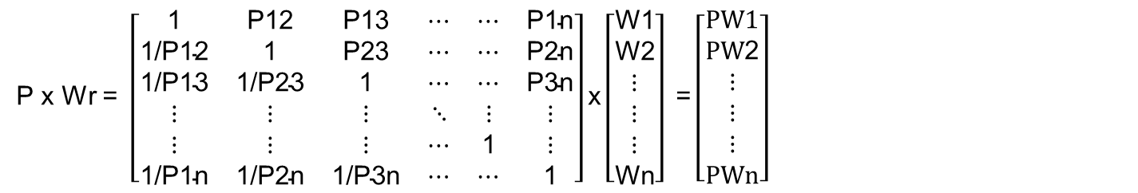
Step 3: Calculate weightings: W1 W2 … Wn (also known as eigen value), and form the weighting matrix Wr, expressed as:
$$\text{Wr}\text{ = }\left[\begin{aligned}\text{W}\text{1} \\ \text{W}\text{2} \\ \text{⋮} \\ \text{⋮} \\ \text{⋮} \\ \text{Wn}\end{aligned}\right]$$
Eq.3
Where W1 = $\frac{\text{N}\text{1}\text{1}+…\text{N}\text{1}\text{n}}{n}$; W2 = $\frac{\text{N}\text{2}\text{1}+…\text{N}\text{2}\text{n}}{n} ….$ Wn = $\frac{\text{N}\text{n}\text{1}+…\text{N}\text{n}\text{n}}{n}$
Step 4: Conducting the consistency check (by calculating the normalised weightings) via calculating Eq.1 x Eq.3, expressed as:
P x Wr $\text{= }\left[\begin{matrix}\text{1} & \text{P}\text{12} & \text{P}\text{13} & \text{⋯} & \text{⋯} & \text{P}\text{1}\text{n} \\ \text{1/}\text{P}\text{12} & \text{1} & \text{P}\text{23} & \text{⋯} & \text{⋯} & \text{P}\text{2}\text{n} \\ \text{1/}\text{P}\text{13} & \text{1/}\text{P}\text{23} & \text{1} & \text{⋯} & \text{⋯} & \text{P}\text{3}\text{n} \\ \text{⋮} & \text{⋮} & \text{⋮} & \text{⋱} & \text{⋮} & \text{⋮} \\ \text{⋮} & \text{⋮} & \text{⋮} & \text{⋯} & \text{1} & \text{⋮} \\ \text{1/}\text{P}\text{1}\text{n} & \text{1/}\text{P}\text{2}\text{n} & \text{1/}\text{P}\text{3}\text{n} & \text{⋯} & \text{⋯} & \text{1}\end{matrix}\right]\text{x}\left[\begin{aligned}\text{W}\text{1} \\ \text{W}\text{2} \\ \text{⋮} \\ \text{⋮} \\ \text{⋮} \\ \text{Wn}\end{aligned}\right] \text{=}\left[\begin{aligned}\text{PW}1 \\ \text{PW}\text{2} \\ \text{⋮} \\ \text{⋮} \\ \text{⋮} \\ \text{PW}\text{n}\end{aligned}\right]$
Eq.4

Slide 25
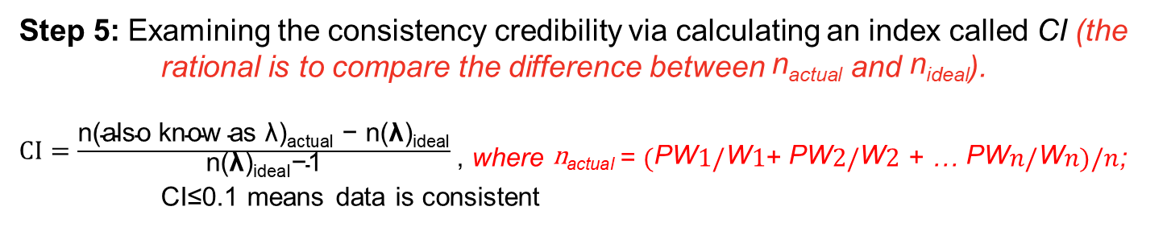
In decision-making it is important to examine the consistency credibility. This could be mathematically explained as: if Eq.2 is an ideal positively-invering matrix, Eq.4 should be equal to $\text{n}$ times Eq.3, which is n x Wr. See below:
$$\left[\begin{aligned}\text{PW}1 \\ \text{PW}\text{2} \\ \text{⋮} \\ \text{⋮} \\ \text{⋮} \\ \text{⋮} \\ \text{PWn}\end{aligned}\right] is supposed to equal to:$$
$$\left[\begin{matrix}\frac{\text{W}\text{1}}{\text{W}\text{1}} & \frac{\text{W}\text{1}}{\text{W}\text{2}} & \text{⋯} & \text{⋯} & \frac{\text{W}\text{1}}{\text{W}\text{n}} \\ \frac{\text{W}\text{2}}{\text{W}\text{1}} & \frac{\text{W}\text{2}}{\text{W}\text{2}} & \text{⋯} & \text{⋯} & \frac{\text{W}\text{2}}{\text{W}\text{n}} \\ \text{⋮} & \text{⋮} & \text{⋱} & \text{⋮} & \text{⋮} \\ \text{⋮} & \text{⋮} & \text{⋯} & \text{⋱} & \text{⋮} \\ \frac{\text{W}\text{n}}{\text{W}\text{1}} & \frac{\text{W}\text{n}}{\text{W}\text{2}} & \text{⋯} & \text{⋯} & \frac{\text{W}\text{n}}{\text{W}\text{n}}\end{matrix}\right]\text{x}\left[\begin{matrix}\text{W}\text{1} \\ \text{W}\text{2} \\ \text{⋮} \\ \text{⋮} \\ \text{⋮} \\ \text{⋮} \\ \text{W}\text{n}\end{matrix}\right] \text{=} \text{n}\text{(}\text{also} \text{know} \text{as} \text{λ}\text{)}\left[\begin{matrix}\text{W}\text{1} \\ \text{W}\text{2} \\ \text{⋮} \\ \text{⋮} \\ \text{⋮} \\ \text{⋮} \\ \text{W}\text{n}\end{matrix}\right]$$
Step 5: Examining the consistency credibility via calculating an index called CI (the rational is to compare the difference between $\text{n}\text{actual}$ and $\text{n}\text{ideal}$).
$CI=\frac{\text{n}\text{(}\text{also} \text{know} \text{as} \text{λ}\text{)}\text{actual} \text{−} \text{n}\text{(}\text{λ}\text{)}\text{idea}\text{l}}{\text{n}\text{(}\text{λ}\text{)}\text{ideal}\text{−1}}$, where $\text{n}\text{actual}$= $(\text{PW}1/\text{W}1$+ $\text{PW}2/\text{W}2$ + … $\text{PW}n/\text{W}n)/n$; CI≤0.1 means data is consistent
Notes:
λ is a constant

Slide 26
Questions: Identify the significance levels of “Environmental (En)”, “Economic (Ec)”, “Social (Sc)” and “Functional (Fn)” to the community development. In other words, to derive their weightings using AHP!
The captured pairwise comparison given by an expert (this is the prerequisite of conducting AHP) for four sustainability criteria is: EnEc=1; EnSc=5; EnFn=3; EcSc=5; EcFn=3; ScFn=1;
However, these are originally the qualitative indication of significance, therefore do no represent the actual weighting ratio – that is why we have to verify the significance FAIRLY using AHP!

Slide 27
Step 1 (Positively Inversing Matrix)
This is supposed to be 0.2/0.33333. But as long as this value is approximately-proportionally-equal, it is fine!
 | En | Ec | Sc | Fn
En | 1 | 1 | 5 | 3
Ec | 1 | 1 | 5 | 3
Sc | 0.2 | 0.2 | 1 | 1
Fn | 0.333333 | 0.333333 | 1 | 1
$$Ʃ$$ | 2.533333 | 2.533333 | 12 | 8
Weighting values of each criterion
Step 2 & 3
 | En | Ec | Sc | Fn | Sum | Weighting
En | 1/2.5333 = 0.3947 | 0.3947 | 0.4167 | 0.3750 | 1.5811 | 1.5811/4 = 0.3953
Ec | 0.3947 | 0.3947 | 0.4167 | 0.3750 | 1.5811 | 1.5811/4 = 0.3953
Sc | 0.0789 | 0.0789 | 0.0833 | 0.1250 | 0.3662 | 0.3662/4 = 0.0916
Fn | 0.1316 | 0.1316 | 0.0833 | 0.1250 | 0.4715 | 0.4715/4 = 0.1179
Sum | 1.0000 | 1.0000 | 1.0000 | 1.0000 | 4.0000 | 1.0000

Slide 28
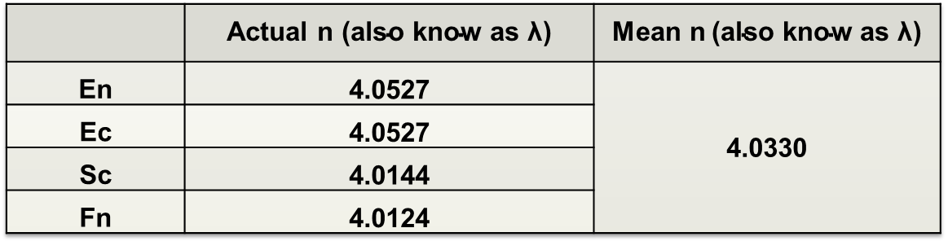
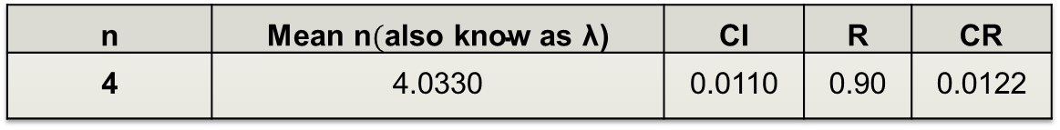
Step 4 (an additional step is to check the weighting consistency!!)
Hence, the consistency of data is confirmed.
 | Actual n $\text{(}\text{also} \text{know} \text{as} \text{λ}\text{)}$ | Mean n$\text{(}\text{also} \text{know} \text{as} \text{λ}\text{)}$
En | 4.0527 | 4.0330
Ec | 4.0527
Sc | 4.0144
Fn | 4.0124
n | Mean n$(\text{also} \text{know} \text{as} \text{λ}\text{)}$ | CI | R | CR
4 | 4.0330 | 0.0110 | 0.90 | 0.0122

